Slide 1

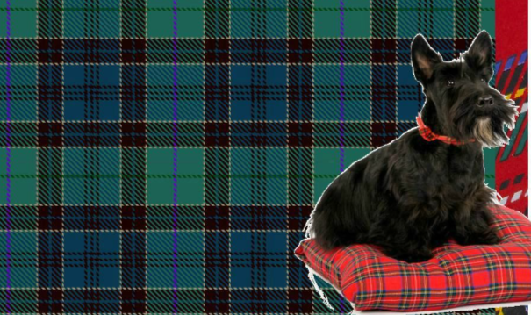
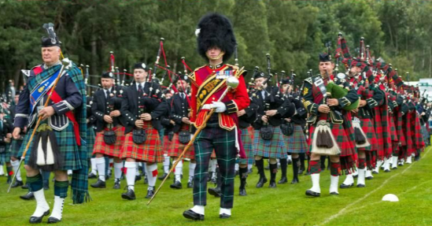
Can you solve this riddle?
I have a blue and white flag but I’m not Finland.
I’m in Europe but I’m not Greece.
I have a famous monster but it’s not Bigfoot.
I’m a part of Great Britain but I’m not England.
I’m well known for my bagpipes but I’m not Turkey.
What am I?

Slide 2


Scotland
ACROSS CULTURES

Slide 3

Watch the video. Write down three interesting facts about Scotland.

Slide 4
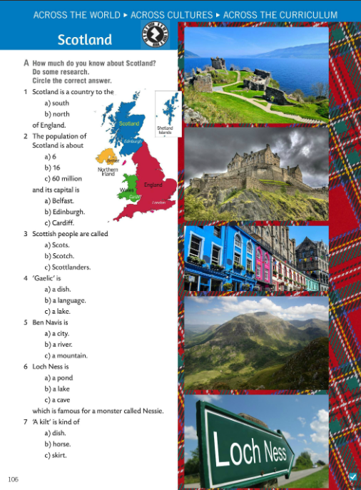
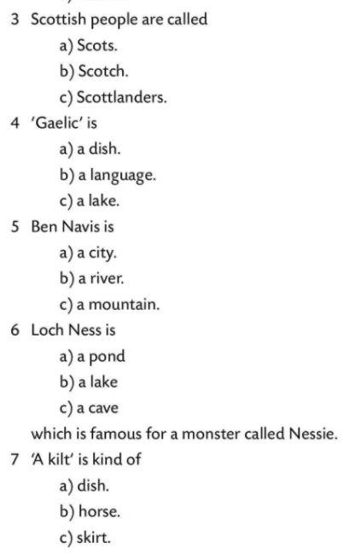
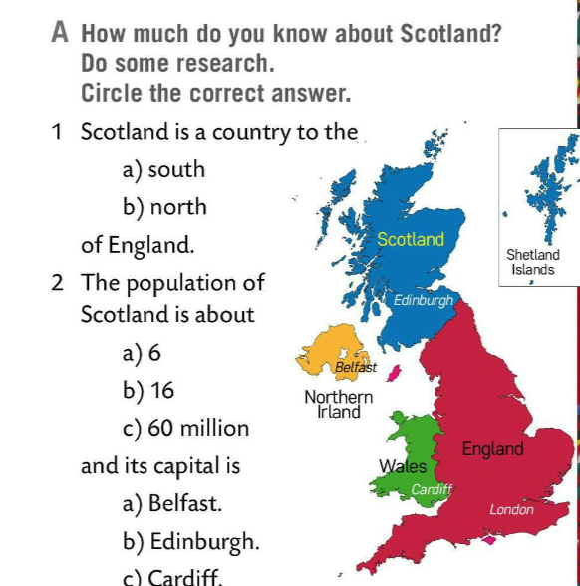
How much do you know about Scotland? Read the questions and do some research.
Then answer the questions.
Check.

Slide 5
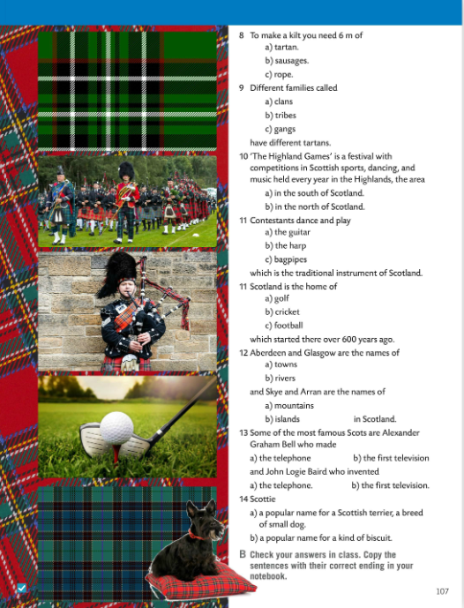
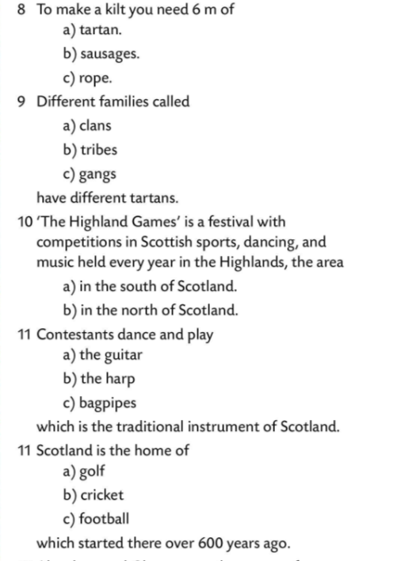
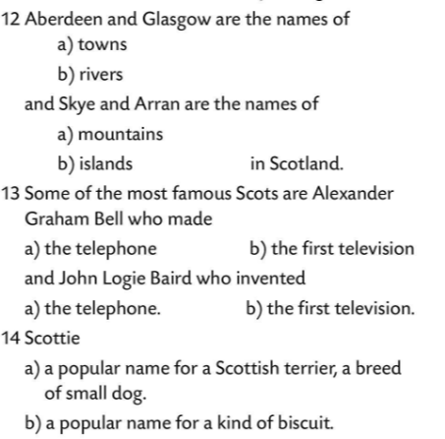

How much do you know about Scotland? Read the questions and do some research.
Then answer the questions.
Check.

Slide 6
Work in pairs. Translate the following words into Croatian.
loch
pond
kilt
tartan
clan
contestants
bagpipes
dish
river
lake
Scotland (Scots / Scottish)
jezero
ribnjak
dio škotske muške narodne nošnje
karirani škotski uzorak
pleme
natjecatelji
gajde
jelo
rijeka
jezero
Škotska (Škoti/škotski)

Slide 7
Copy sentences. Work in pairs and fill in the gaps. Check your answers in class.
a country
Scotland is ________ to the north of England.
The population of Scotland is about ______ and its capital is ______.
Scottish people are called _______ and Gaelic is a __________.
Ben Nevis is a ____________ . Loch Ness is a ________.
_________ is a kind of skirt. To make it, you need 6 m of tartan.
Different families, called __________, have different tartans.
The 'Highland Games' is a __________ with sports, dancing and music competitions, held every year in the Highlands, an area in the north of Scotland.
Aberdeen and Glasgow are the names of _______, and Skye and Arran are the names of________.
Some of the most famous Scots are Alexander Graham Bell who made the first________, and John Logie Baird who invented the___________.
6 millions
Edinburgh
Scots
language
mountain
lake
A kilt
clans
festival
towns
islands
telephone
television

Slide 8
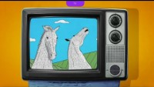

Watch two more videos on Scotland’s art and Hihghland games.

Slide 9


Let’s revise. Play a quiz in teams and the winning team can weave their own tartan.
Winners can visit Interactive Tartan Weaver. This unique site gives you the chance to design your own Tartan.
Play this quiz. May the best clan win.
https://wordwall.net/play/11643/853/303
https://houseoftartan.co.uk/interactive/weaver/index.html

